Slide 1
Recycling Clothes, Shoes,
and Household Textiles:
What You Need to Know
DATE

Slide 2
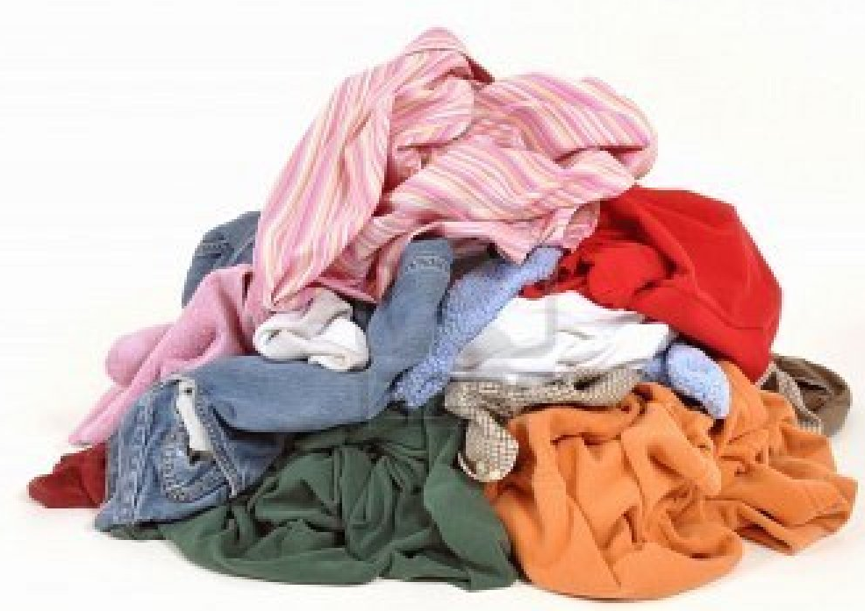
New York trashes 1.4 billion pounds of clothing, shoes, and other textiles each year.

Slide 3
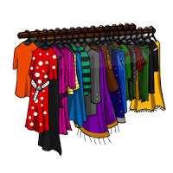
Environmental
95% of those textiles can be donated or recycled.
Instead, they head for a landfill.

Slide 4
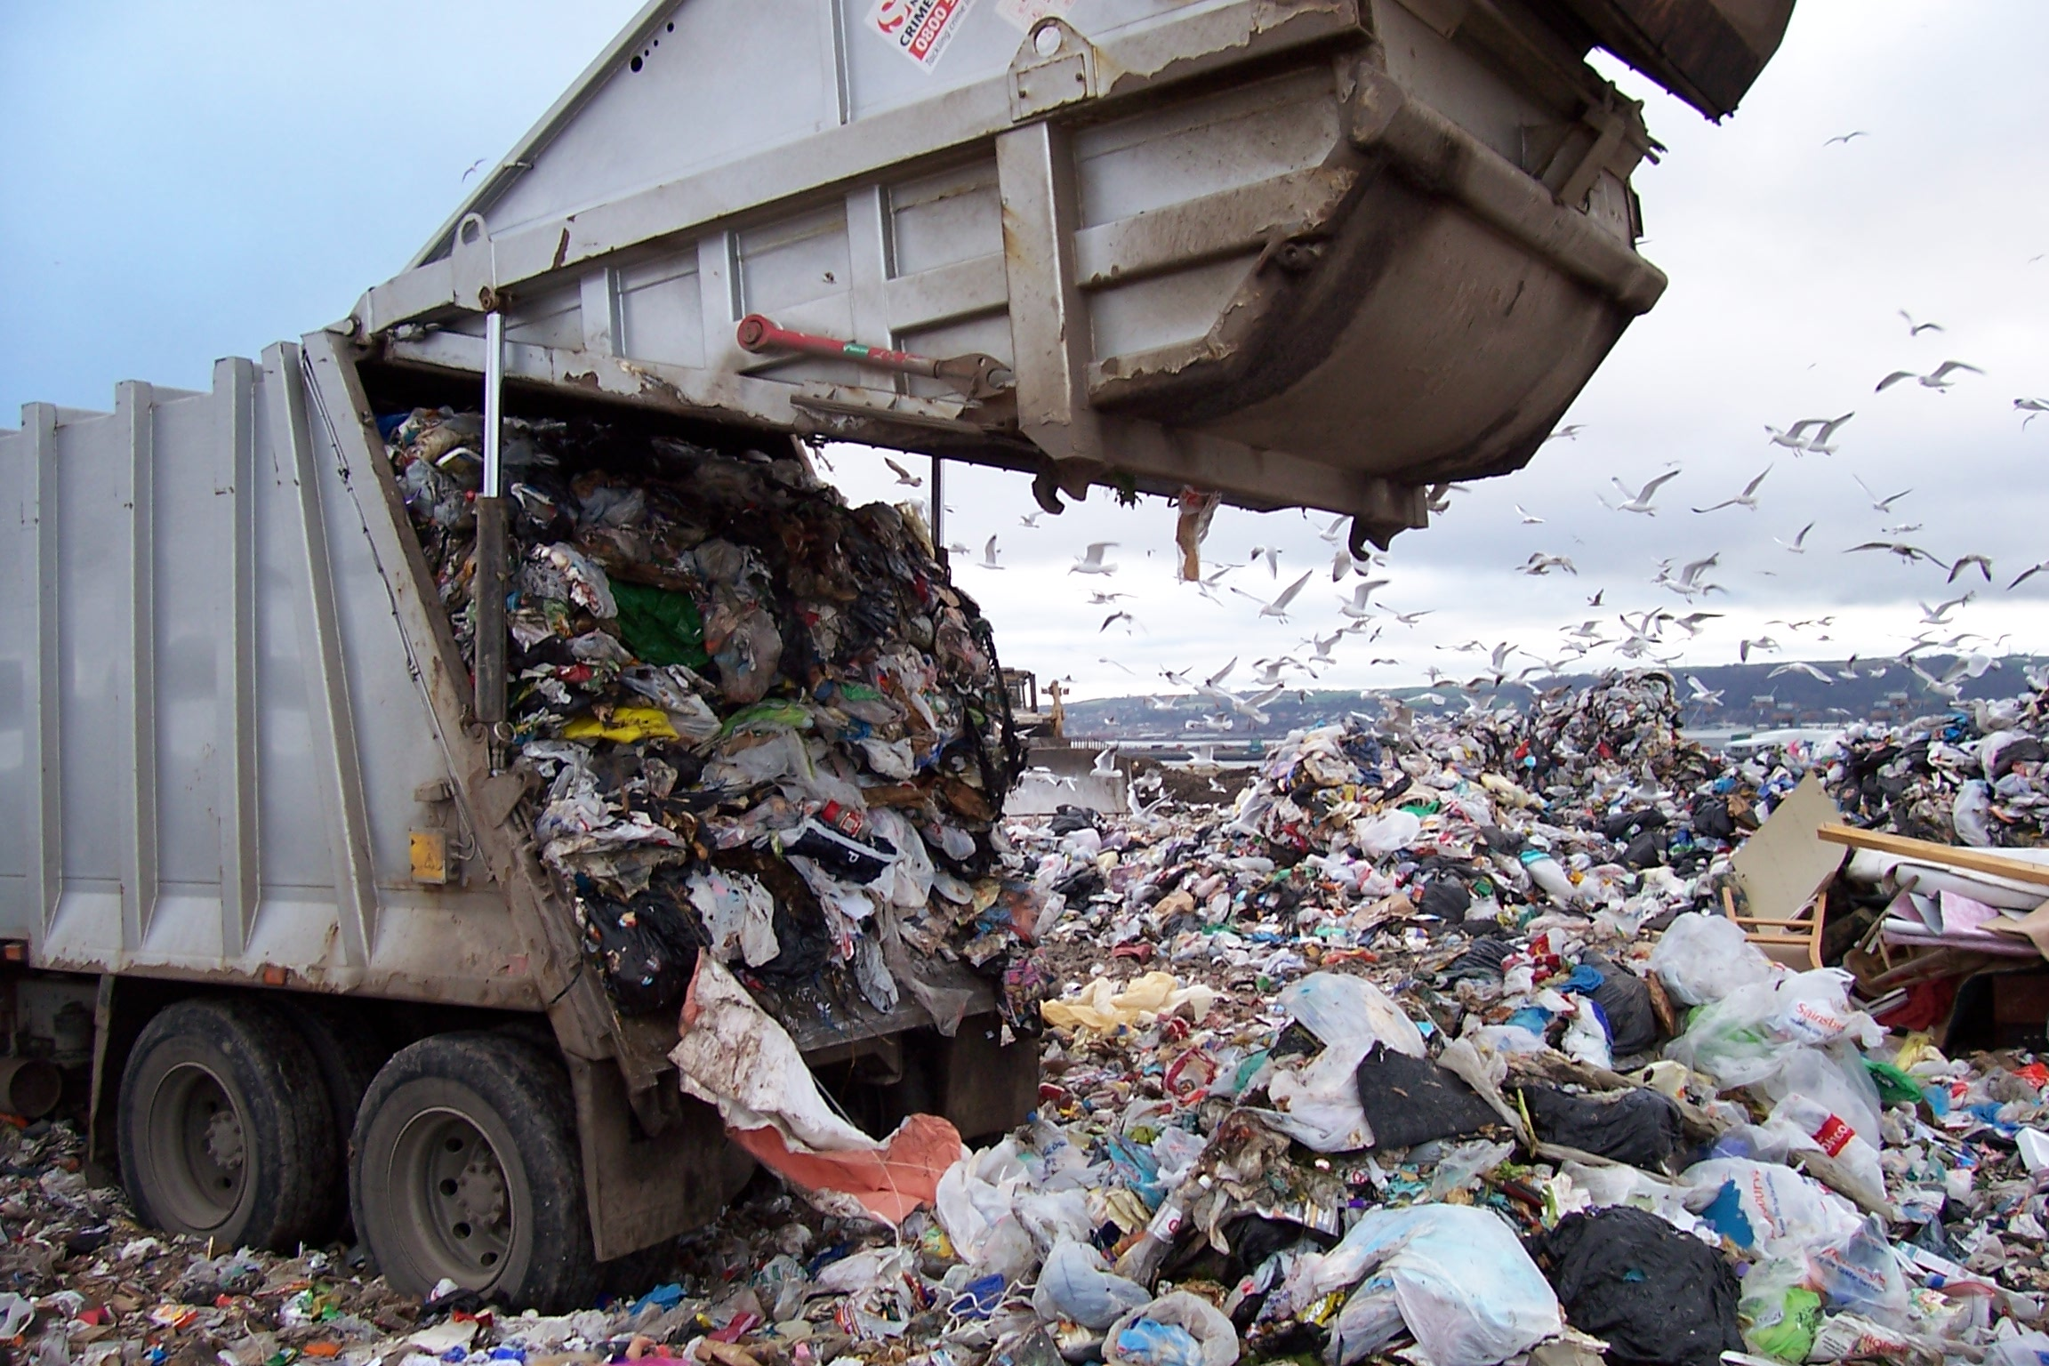
Textiles make up an estimated 5% of all landfill space.

Slide 5
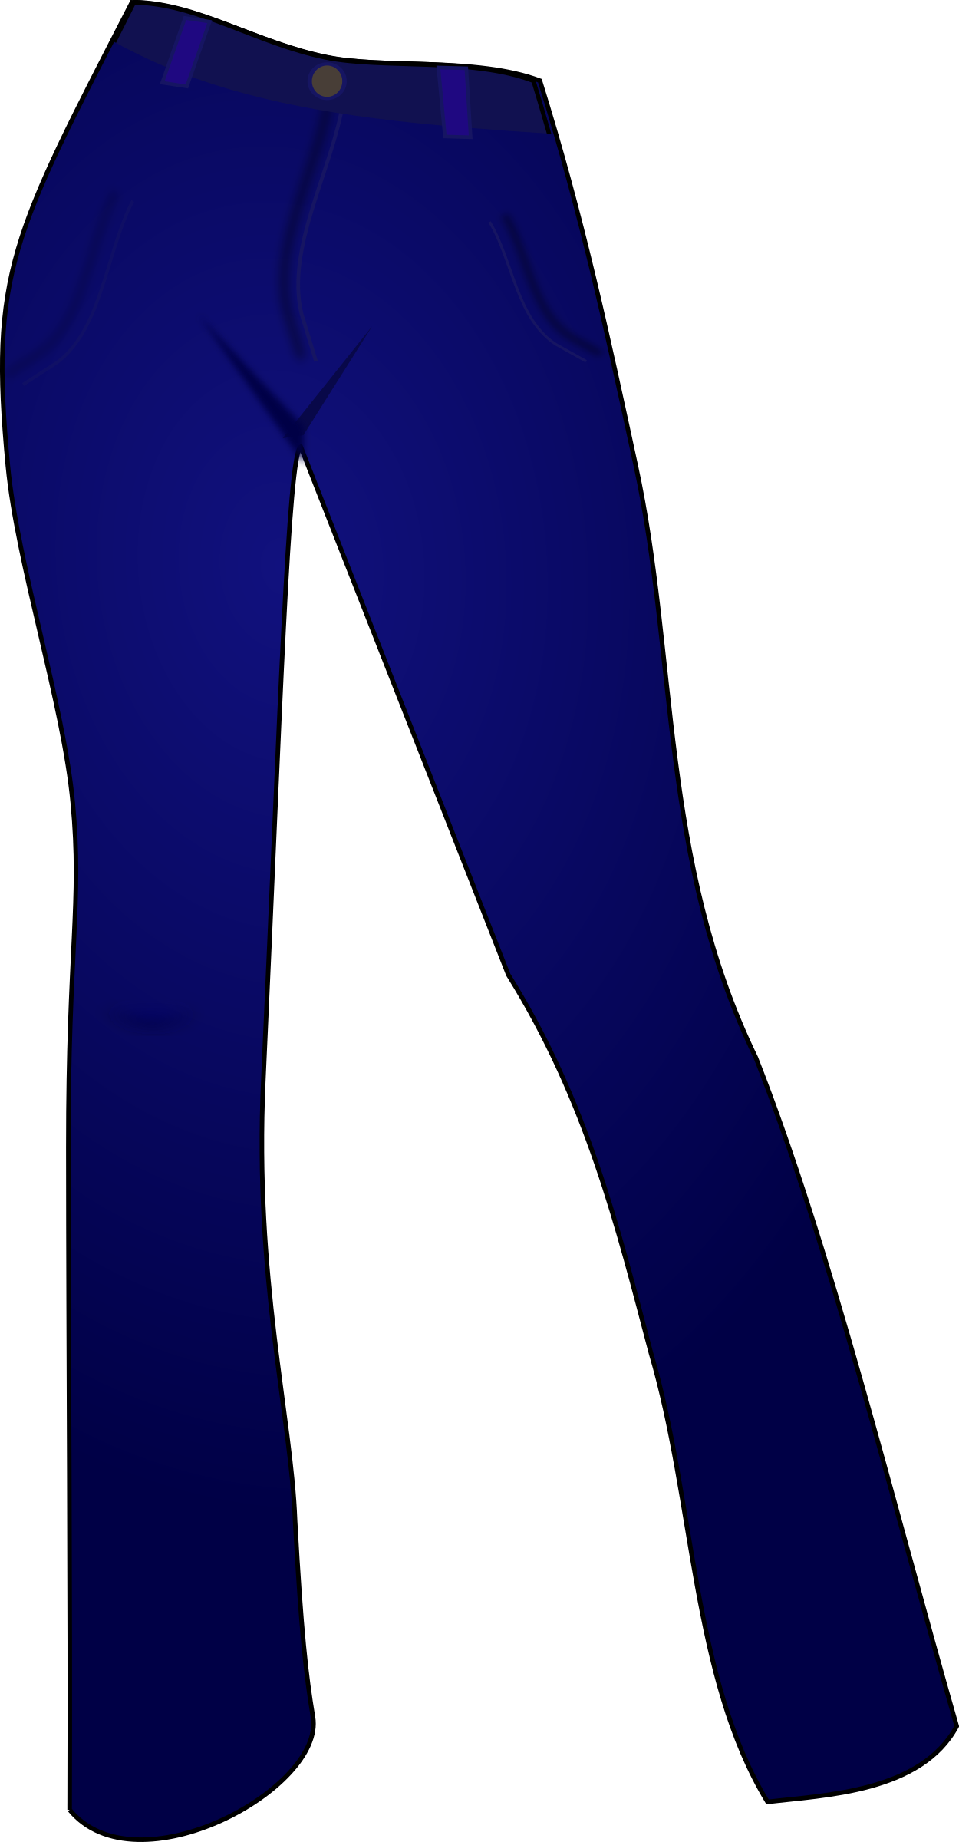
Environmental
It takes 2,900 gallons of water,
or 10,978 liters, to make
one pair of jeans.

Slide 6
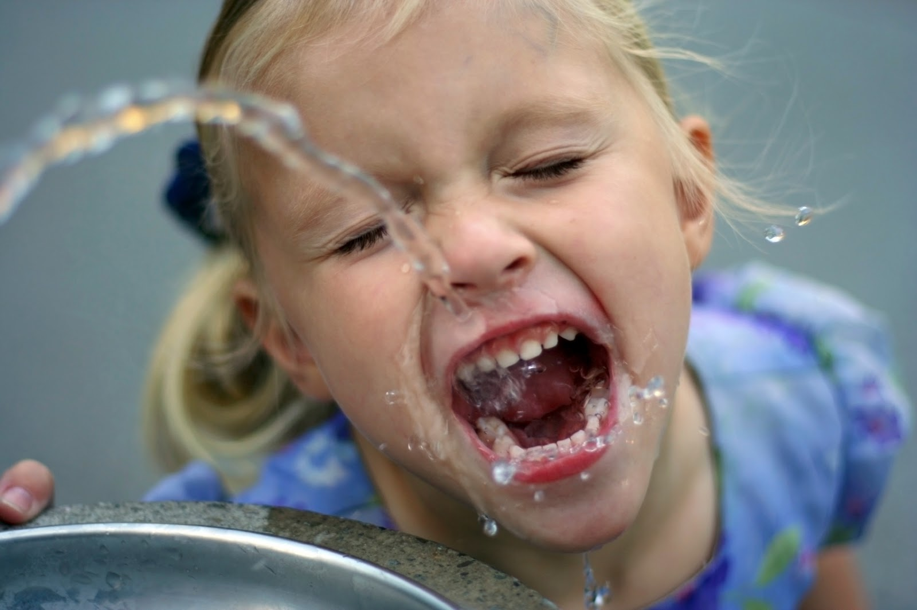
One person uses
~20 liters of water each day.
Reusing jeans rather than buying new saves enough water to hydrate 549 people – for 1 day!

Slide 7
Economic
All of those textiles have an estimated market value of
$130 million dollars.
Recycling those textiles could create 1,000 jobs.

Slide 8
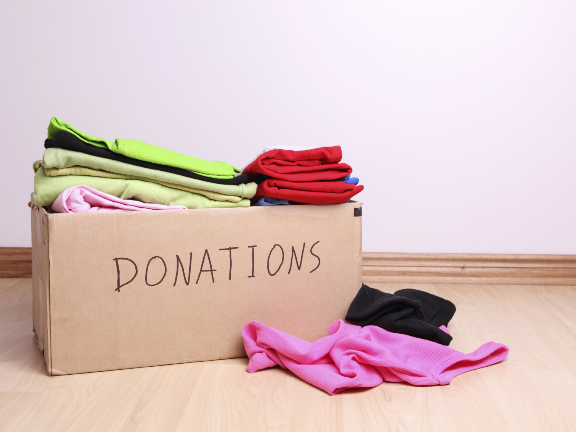
So what can you do?
DONATE!

Slide 9
Worn, torn, or stained?
ALL textiles –
from faded to fashionable –
can be donated, as long as they’re
clean, dry, and odorless.

Slide 10
What can I recycle?
Footwear (single or in pairs):
Shoes
Heels (wedges, pumps)
Flats
Sandals
Flip Flops
Boots
Sneakers
Cleats
Slippers
Clothing:
Tops, sweaters, sweatshirts
Dresses
Outerwear (coats, jackets, blazers)
Bottoms (pants, slacks, jeans, sweatpants, shorts)
Suits
Socks
Pajamas, slips
Bras, underwear

Slide 11
What can I recycle?
Accessories:
Hats
Bags (purses, totes, backpacks, duffle bags)
Belts
Gloves
Ties
Scarves
Bathrobes
Linens:
Sheets
Blankets
Towels
Curtains/Drapes
Aprons
Dish cloths
Cloth napkins
Table linens
Comforters
Throw rugs
Placemats
Other:
All stuffed animals
Halloween costumes
Sports jerseys
Pet beds and clothing
Rags
Pillows
Canvas

Slide 12
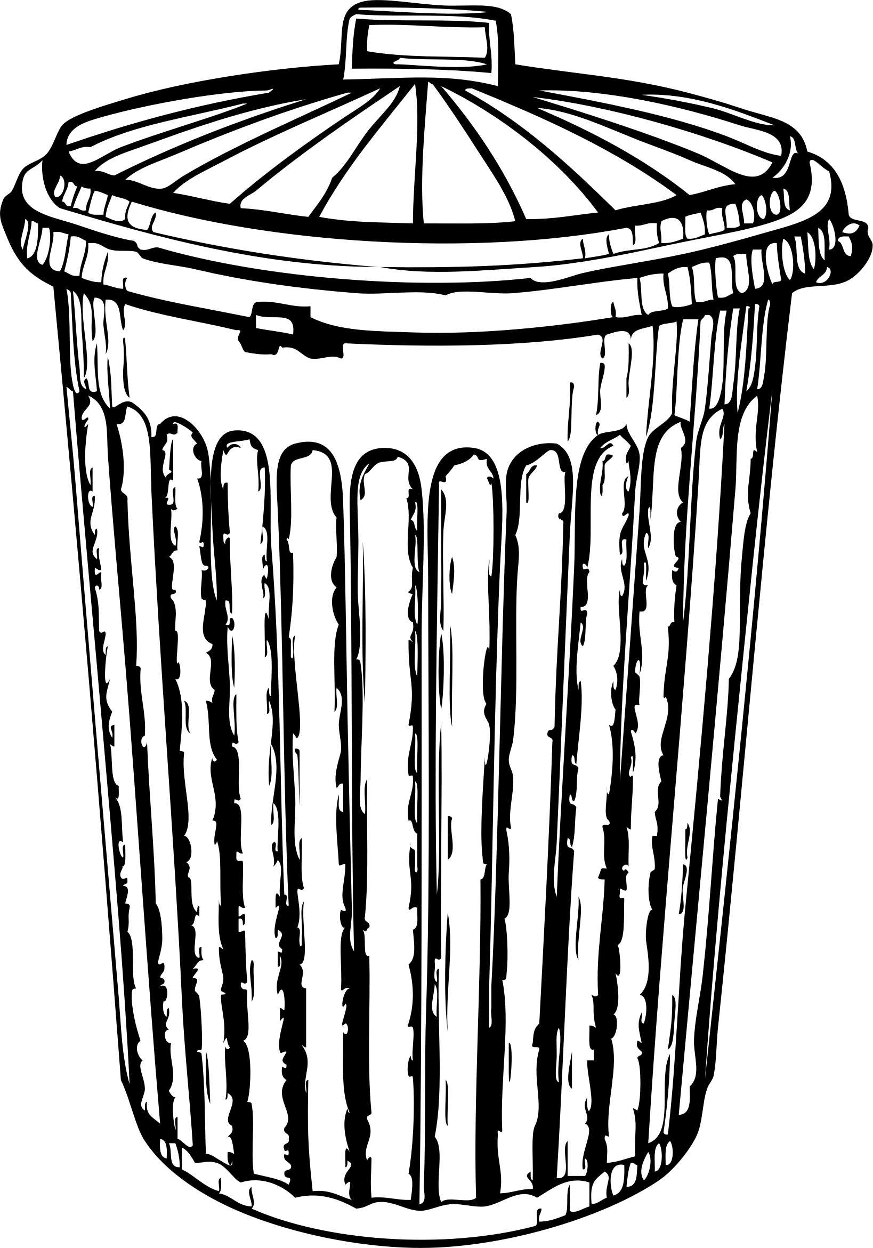
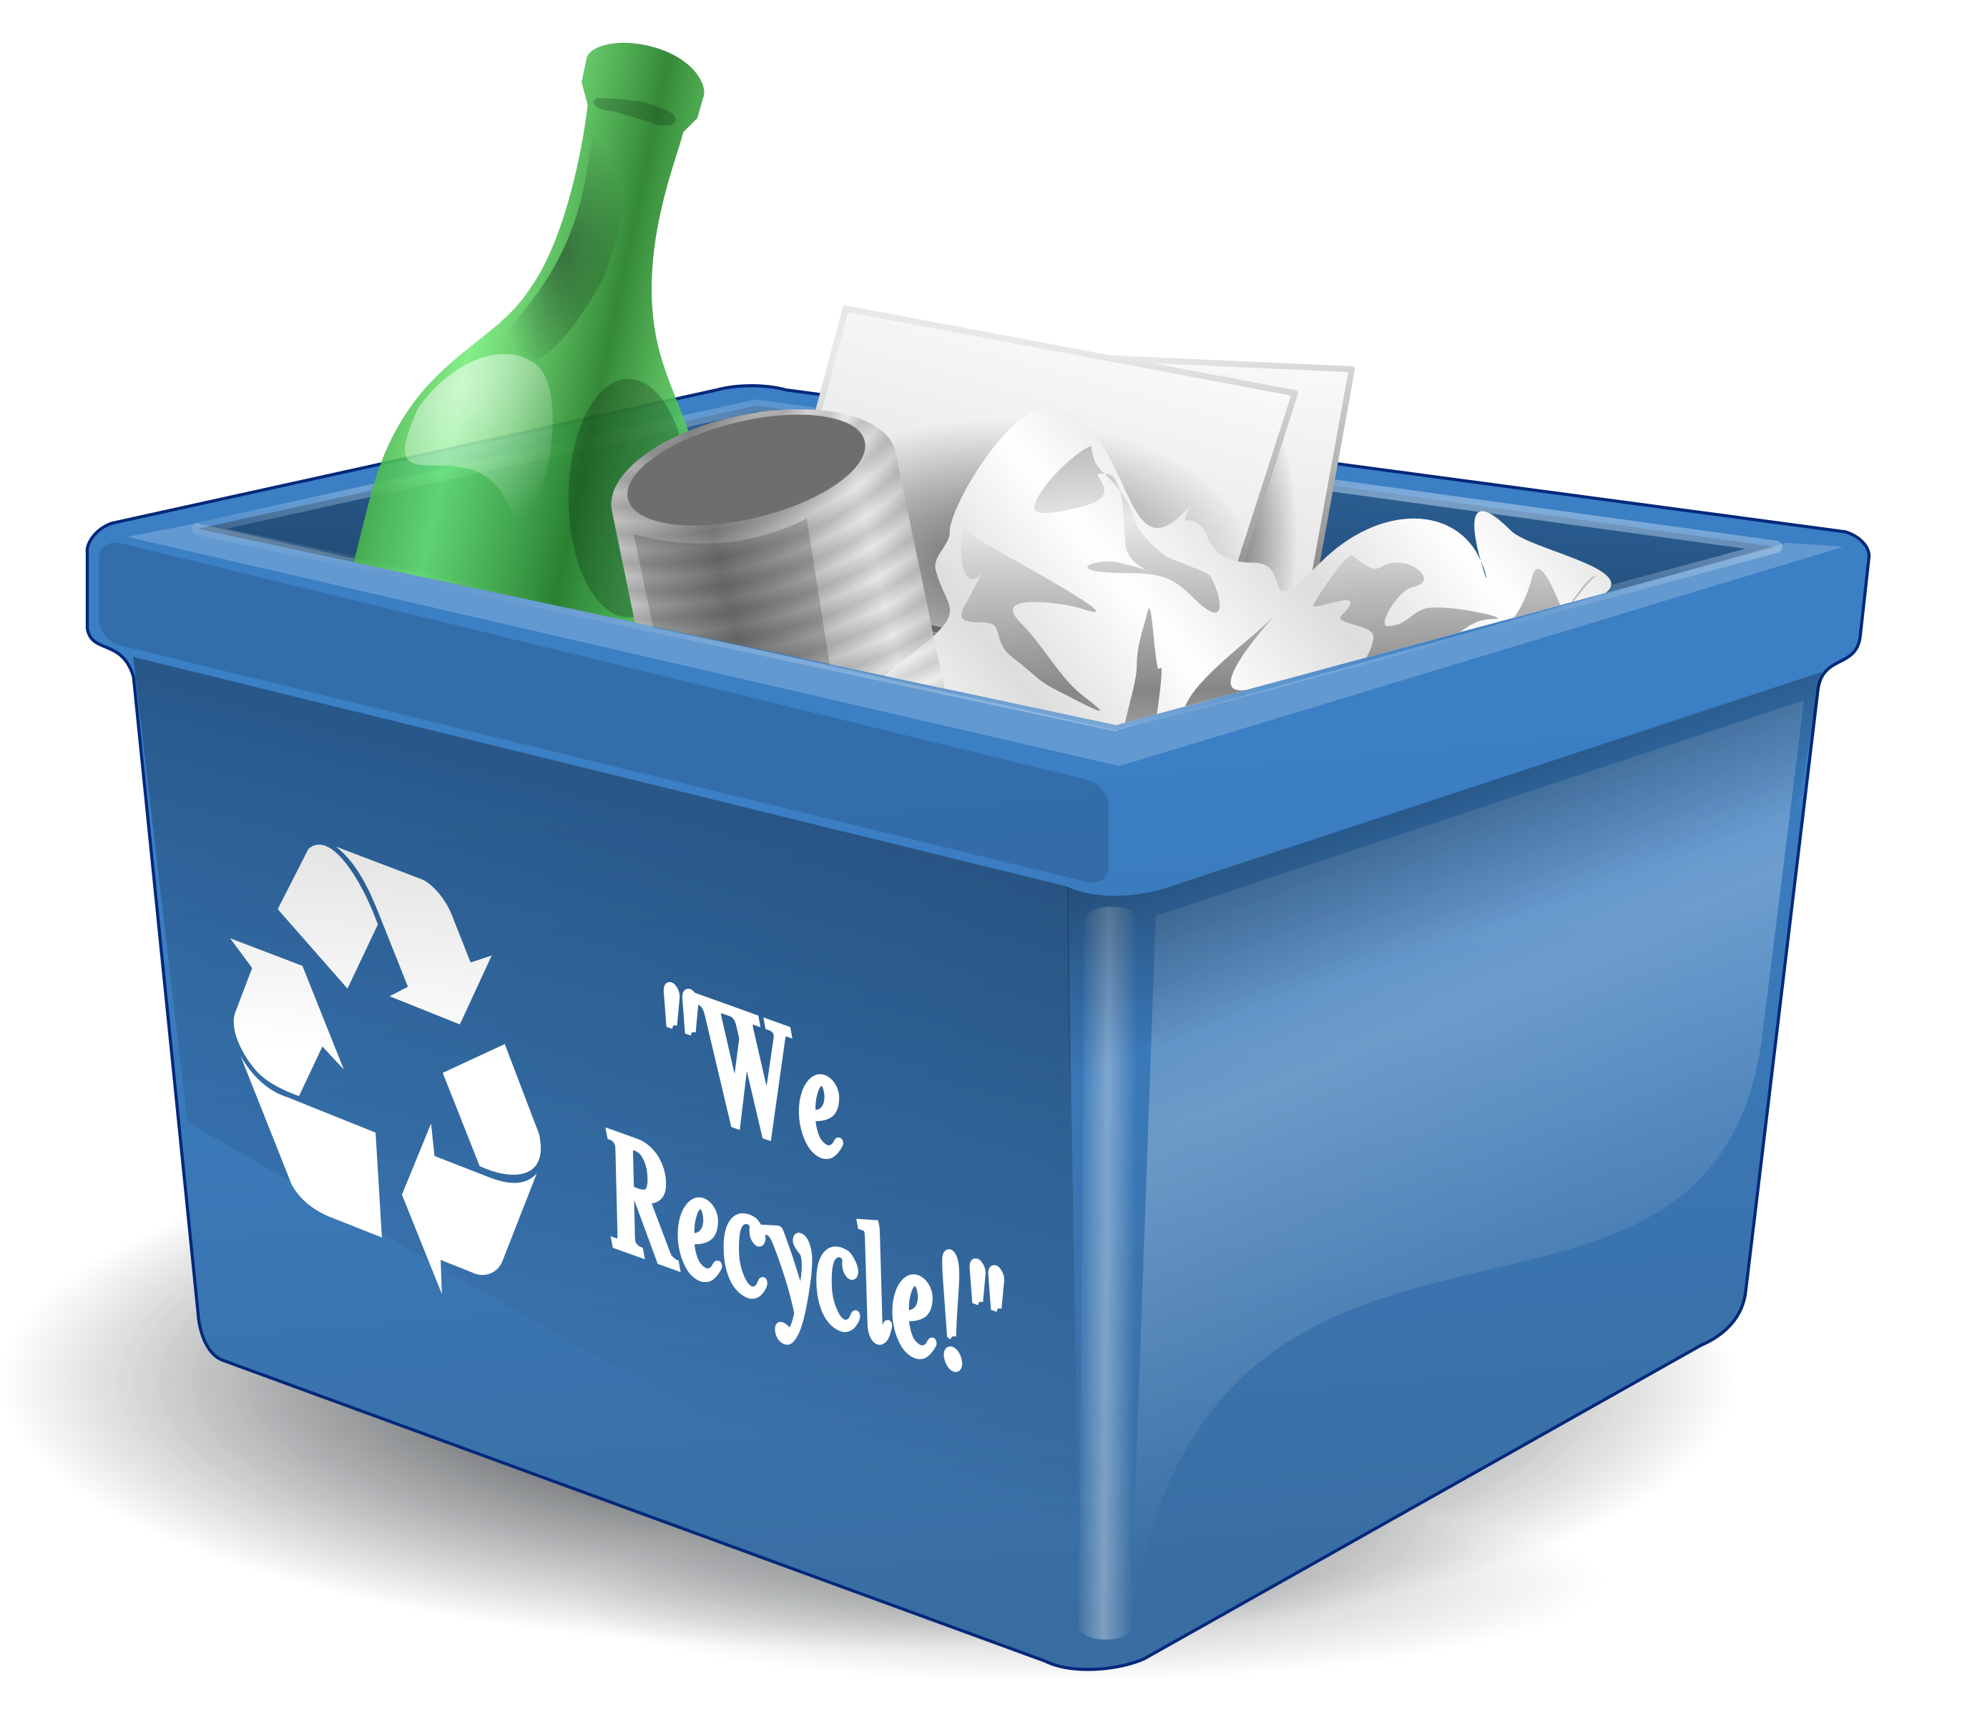
How do I recycle?

Slide 14
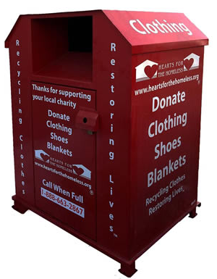
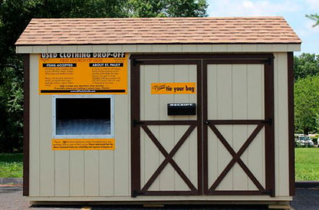
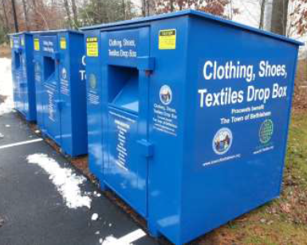
Drop off in a bin or at a collection event!

Slide 15
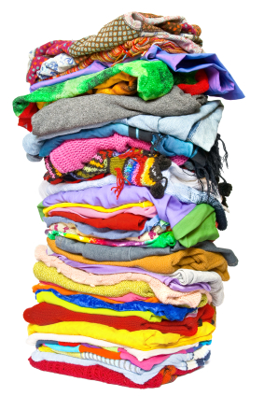
Reuse vs. recycling
Reuse: Textiles that are sold in a thrift store or to developing nations.
Recycling: Textiles that are converted
to wiping rags or ground up into fiber.

Slide 17
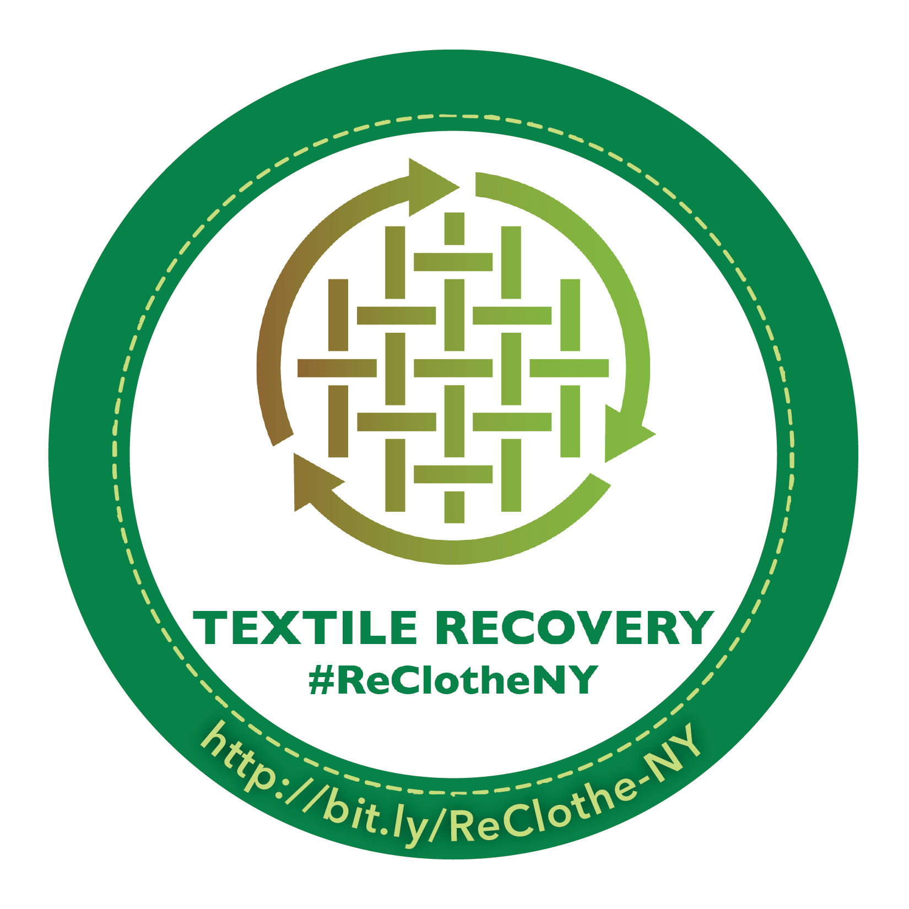
When you donate…
Look for the Re-Clothe NY decal!

Slide 18
Who is Re-Clothe NY?
The Re-Clothe NY Coalition is a collaborative group of recyclers, non-profits, and governments that adhere to honest, agreed-upon standards for processing donated textiles.

Slide 19
How else can I help?
Visit bit.ly/ReClothe-NY
Spread the word about the need for, and how to, donate textiles for recycling.
Download outreach tools: social media posts, fact sheet, posters, media releases, K-12 resources, etc.

Slide 20
Citations
Slide 2: New York State Department of Environmental Conservation. (2014). Textile Reuse and Recycling [Webpage]. Retrieved 1 September 2016. www.dec.ny.gov/chemical/100141.html.
Slide 3: Estimation by the New York State Association for Reduction, Reuse, and Recycling (NYSAR3); Secondary Materials and Recycled Textiles (SMART); and the Council for Textile Recycling (CTR).
Slide 4: U.S. Environmental Protection Agency. (2012). Municipal Solid Waste Generation, Recycling, and Disposal in the United States: Facts and Figures for 2012.
Slide 5: Water Footprint Network. (2010). Water Footprint Data [Webpage]. Retrieved 1 September 2016. waterprint.net/jeans.html.
Slide 6: World Health Organization. (2013). Technical notes on drinking-water, sanitation and hygiene in emergencies. Retrieved 1 September 2016. http://www.who.int/water_sanitation_health/publications/2011/WHO_TN_09_How_much_water_is_needed.pdf?ua=1.
Slide 7: New York Textiles Coalition. (2016). At a market value of $0.10/lb (SMART and CTR estimates cross-referenced on Recyclers Exchange http://www.recycle.net/Textile/clothing/xv141500.html, retrieved 9 September 2016), the estimated 1.4 billion pounds of textiles disposed annually in New York have a potential total market value of over $130M. At an estimated average salary of $35,000 per worker, and estimated operational costs (e.g., truck, gas, storage bin) of $100,000, the estimated 1.4 billion pounds of textiles disposed annually has a potential to create over 1,000 NY jobs (130M / $135,000).

Slide 21
Thank you!
PRESENTER NAME
AGENCY/ORGANIZATION
CONTACT INFO

